Slide 1

Project 2: Axis Insurance
Presented by : Nimra Sharif

Slide 2
Objective
Statistical Analysis of Business Data. Explore the dataset and extract insights from the data. The idea is for us to get comfortable with doing statistical analysis in Python.
Expectation and Requirements:
We are expected to do the following:
Explore the dataset and extract insights using Exploratory Data Analysis.
Prove (or disprove) that the medical claims made by the people who smoke is greater than those who don't? [Hint- Formulate a hypothesis and prove/disprove it]
Prove (or disprove) with statistical evidence that the BMI of females is different from that of males.
Is the proportion of smokers significantly different across different regions? [Hint : Create a contingency table/cross tab, Use the function : stats.chi2_contingency()]
Is the mean BMI of women with no children, one child, and two children the same? Explain your answer with statistical evidence.

Slide 3
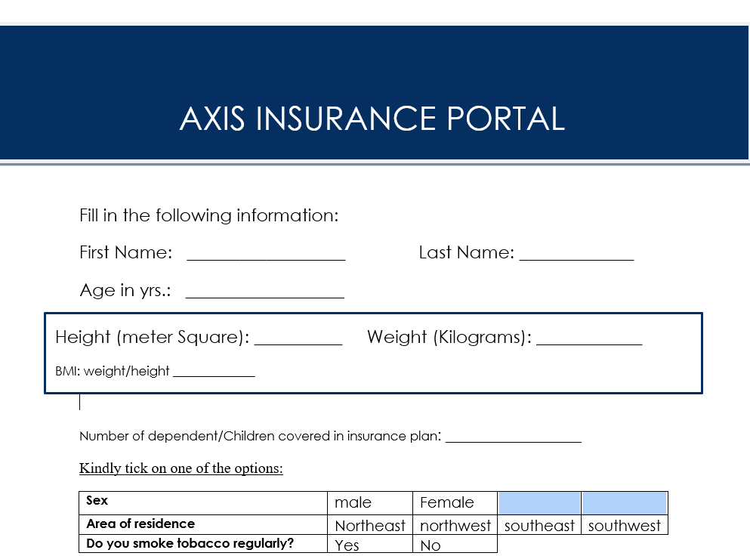
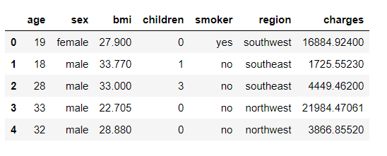
DATA SET
The data set pertains to an insurance company, Axis
.
First five rows of the data set are displayed as follows:
Observations | Columns/Variables | Missing Values | Duplicate
1338 | 7 | 0 | 1

Slide 4
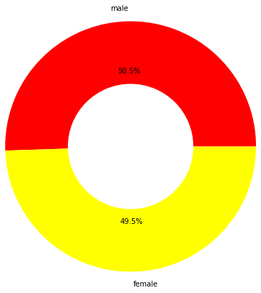
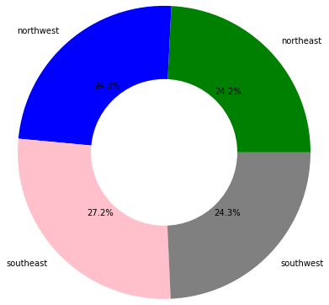
Customer Profile
The highest insured percentage is reported in Southeast.
The southwest, northwest and northeast are having almost same percentage of reported cases.
Male and females are approximately of equal percentage

Slide 5
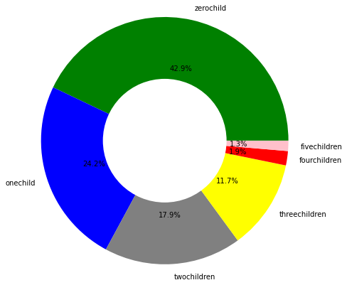
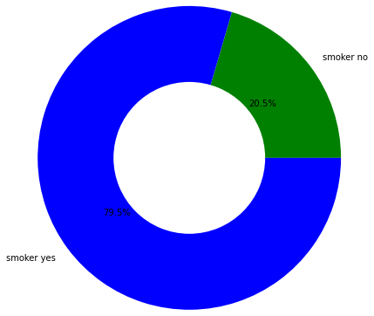
Insured with regular tobacco smoking are more in the data
With the increase in child/dependent the number of insured is decrease.

Slide 6
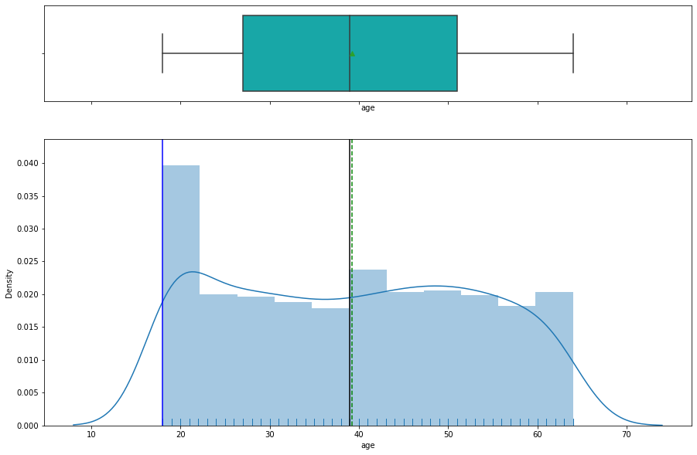
Exploratory Data Analysis –’Age’
The average customer Age is 39.207 or 39 years.
The most repeated Value of the Age is 18 years indicating more insured of this age group in the data.
The 50% of the data lies between the Age bracket of 18-39 years. (18= minimum value, 39 is the median value).
The distribution of Age variable is relatively flatter distribution or seems like a platykurtic distribution.
The boxplot does not indicates any outliers and mean (39.20) and median (39.0) are approximately equal but mode(18) is much lesser than the both.

Slide 7
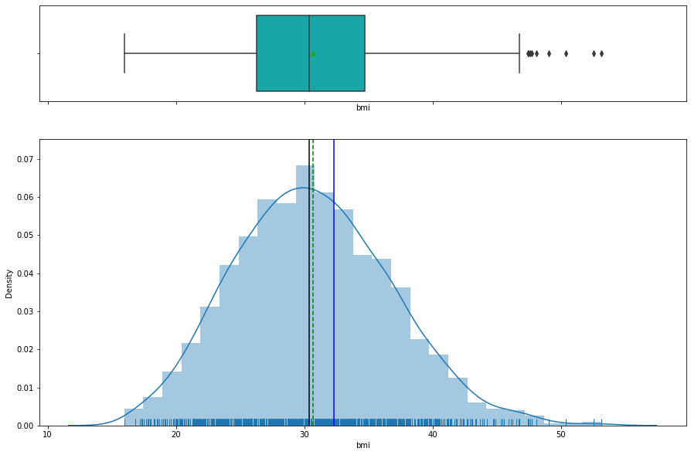
Exploratory Data Analysis –’bmi’
An average bmi of customer is 30.663 + 6.098 which exceed the range of ideal BMI (18.5 to 24.9)and indicates obesity among customers.
The most repeated Value of the bmi is 32.3 indicating more insured belonging to this bmi.
The 50% of the data lies between the bmi bracket of 15.9-30.4. (15.9= minimum value, 30.4 is the median value).
The distribution of bmi variable seems a normal distribution as mean is closer to median and mode.
The boxplot indicates some outliers towards the right side of the data indicating presence of some extreme obese insured individuals.

Slide 8
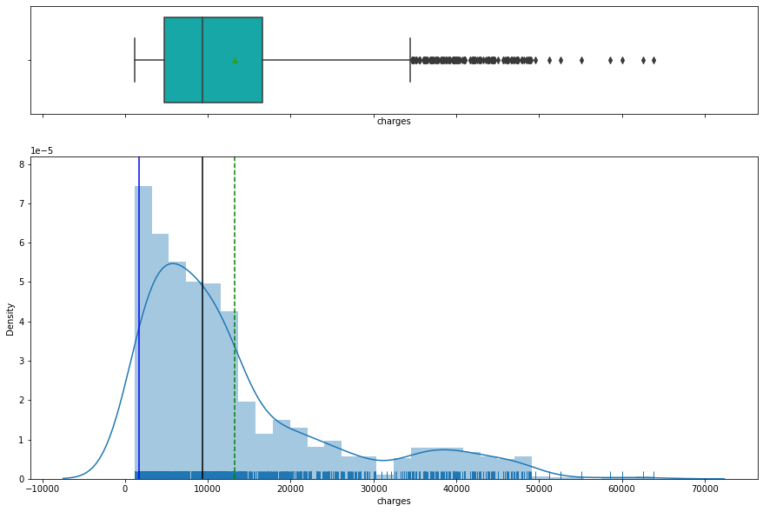
Exploratory Data Analysis –’charges’
The Average Individual medical costs billed to health insurance is 13270.42.
The distribution has long right tail indicating a positive skewed distribution with mean>median>mode.
The distribution is full of outliers on the right side of the data in boxplot indicating huge claims of insured individuals on insurance company.
Data for charges has huge spread ranging from 1121.873 to 63770.428.

Slide 9
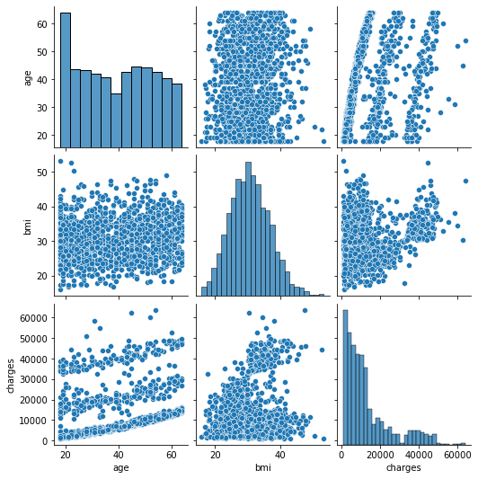
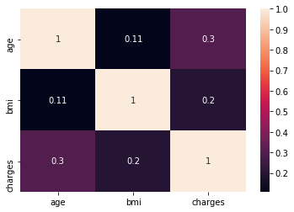
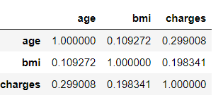
Bivariate Analysis Corrélations for Quantitative Variables (Pearson Product Moment)
None of the correlations seems strong.
A moderate positive correlation can be seen between age and charges (r= 2.99, approx 3).
Relationship between age and bmi (r=0.1092) and charges and bmi (r= 0.198) is very low and indicating lack of interdependence.

Slide 10
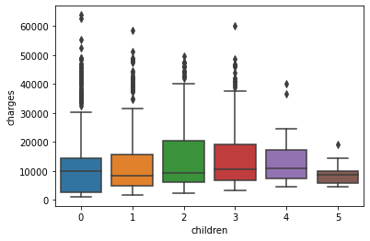
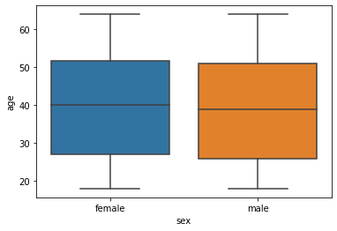
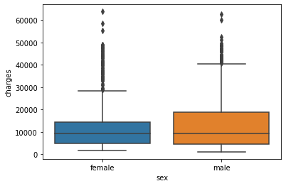
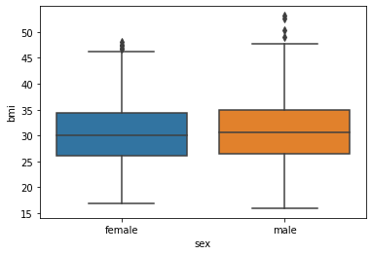
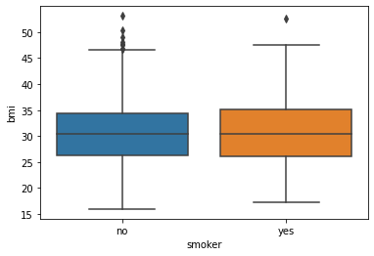
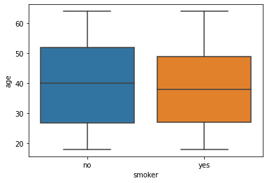
Bivariate Analysis (one Categorical and one quantitative variable)
The highest median value of charges belongs to individuals having 4 children/dependents. whereas, the lowest belong to those having one child/dependent covered in their insurance plan
female and male policy holders seems similar in their ages.
male boxplot extends longer than female one indicating a larger spread of charges claimed by males
frequent smokers are found to be a bit more obese than non smokers but the difference is very minute
median of both sex is above ideal bmi range 18.5 to 24.9.
median age of registered insured who frequently smoke is 2 years less then those who do not

Slide 11
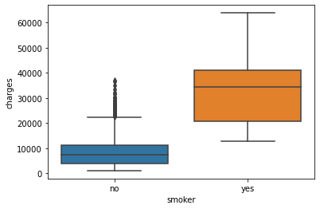
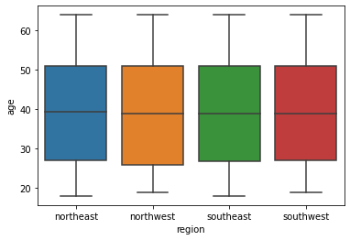
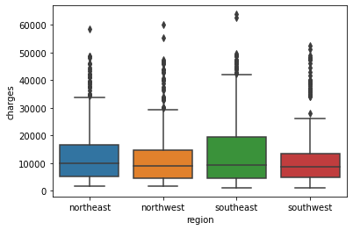
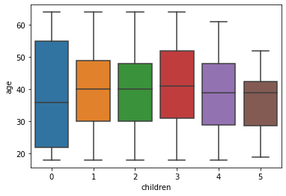
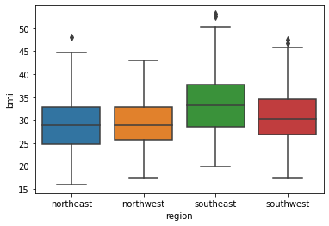
insured that regularly smokes tobacco have much higher medical costs billed to health insurance.
insured at the age of 18 years are found in northeast and southeast but not in northwest and southwest.
most charges are claimed by policy holders of southeast region
The highest spread is reported in the Age variable with respect to 0 number of children/dependents.
The lowest average age is reported for insured having 5 children.
policy holders belonging to northeast and northwest meets have an average bmi

Slide 12
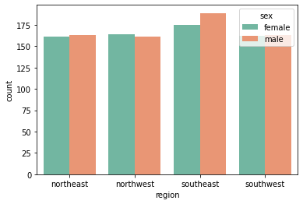
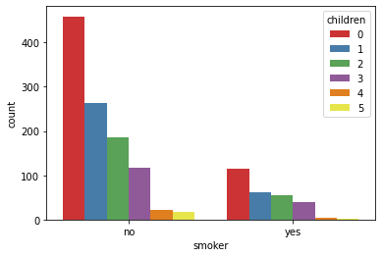
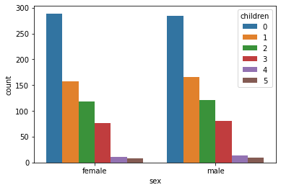
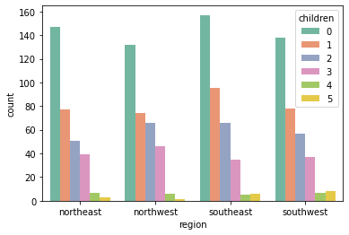
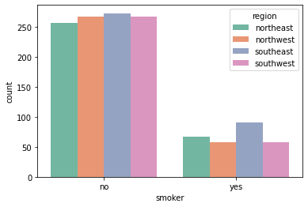
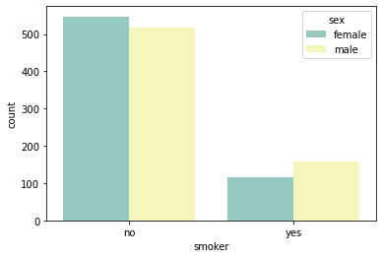
Bivariate analysis with two categorical variable
No relationship between the smoking habits and number of children/dependent
not much variation is found in terms of how many children/dependents covered by male or female
southeast region reports more insured male than females though the female percentage is also high.
females smoke tobacco less frequently then males
No relationship between the smoking habits and number of children/dependent
higher Percentage in southeast

Slide 13
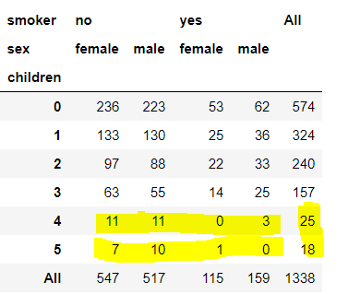
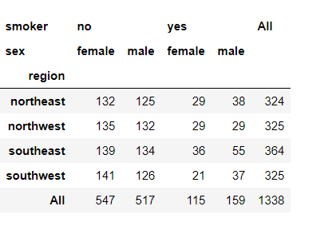
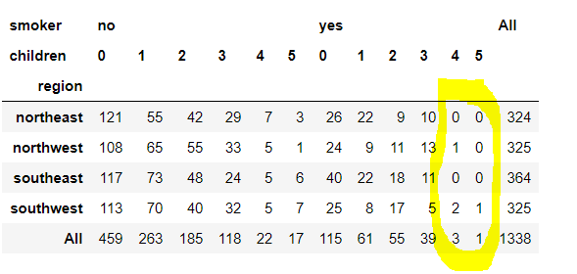
Multivariate Analysis
Cross Tabulation with categorical variable

Slide 14
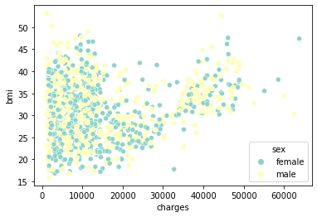
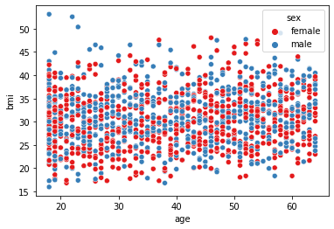
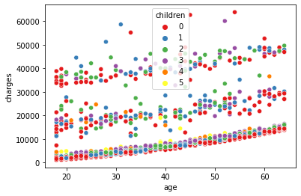
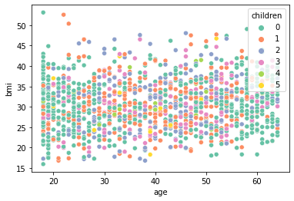
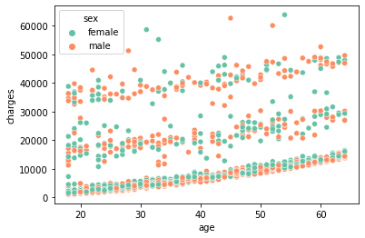
other graphical Analysis
no pattern in the graph
no pattern in the graph
The policy holders with 5 dependent/children covered are found to have low charges and medium age. whereas, the charges also seems to be low for those having 4 dependents irrespective of age.
that insured with 5 children/dependent covered are not seen on higher side age variable
no pattern in the graph

Slide 15
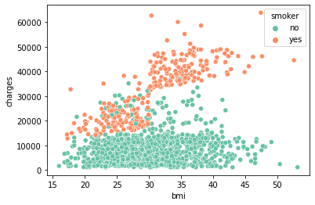
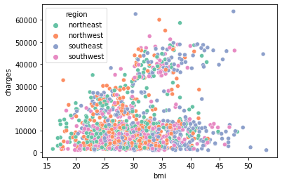
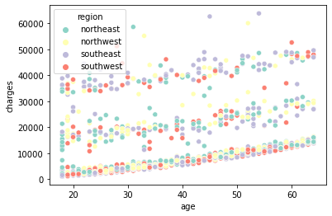
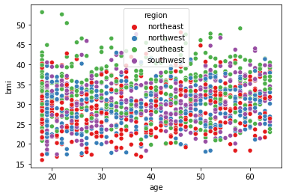
Frequent smokers of tobacco are the one's claims higher charges irrespective of their bmi
area of residence does not moderate this relationship
area of residence does not moderate this relationship
no pattern in the graph

Slide 16
Summary Exploratory data analysis
There are 1338 rows and 7 column in the data set. 1336 rows represent 1338 cases. 7 columns represent 7 different variables.
There are two Categories for Sex, two for smokers, 6 for children and four for region in the data.
An average age of customer is found to be 39.20 + 14.049 years, the standard deviation (14.049) of this variable seems very high.
An average children / dependents covered by the insurance plan for policy holders is 1.09 + 1.205.
An average Individual medical costs billed to health insurance is 13270.42 + 12110.011.
An average bmi of customer is 30.663 + 6.098 which exceed the range of ideal BMI (18.5 to 24.9) and indicates obesity among customers.
More than 75% of customers are above the range of ideal bmi indicating obesity among policy holders. At 25% the value of bmi is 26.296 which is still above 18.5 to 24.9.
Data for charges has huge spread ranging from 1121.873 to 63770.428. The distribution is full of outliers on the right side of the data indicating huge claims of some insured individuals on insurance company.

Slide 17
There exist more insured (79.5%) who smoke tobacco regularly then those who dont (20.5%).
10. The highest insured percentage is reported in Southeast (27.2%). The southwest, northwest and northeast are having almost same percentage of reported cases approximately 24% each.
11. With the increase in child/dependent the number of insured Cases is decreasing. The highest percentage is for insured with 0 children/dependent (42.9%) whereas lowest percentage is for insured with 4 (1.9%) and 5 (1.3%) children/dependents respectively.
12. A moderate positive correlation can be seen between age and charges (r= 2.99, approx 3). Relationship between age and bmi (r=0.1092) and charges and bmi (r= 0.198) is very low and indicating lack of interdependence.
13. Median of both sex bmi is above ideal bmi range 18.5 to 24.9 indicating obesity among both.
14. The male boxplot extends longer than female one indicating a larger spread of charges claimed by males. The 75th value of the male charges (18989.59) is much greater than the female (14454.691825) proving evident of larger claims by men.

Slide 18
The highest median value of charges belongs to individuals having 4 children/dependents. whereas, the lowest belong to those having one child/dependent covered in their insurance plan these findings needs to accessed in detail for appropriate policy recommendation.
Median age of registered insured who frequently smoke is 2 years less then those who do not this findings also need consideration.
frequent smokers are found to be a bit more obese than non smokers but the difference is very minute.
insured that regularly smokes tobacco have much higher medical costs billed to health insurance then those who do not smoke regularly.
The highest spread is reported in the Age variable with respect to 0 number of children/dependents. The lowest average age variable spread is reported for insured having 5 children, this finding also needs to elaborated.
Not much difference when beneficiaries ages are inspected with respect to their region of residence except that insured at the age of 18 years are found in northeast and southeast but not in northwest and southwest.
policy holders belonging to northeast and northwest meets have an average bmi that falls under ideal bmi range. The most obesity is found in southeast followed by southwest regions.

Slide 19
Most charges are claimed by policy holders of southeast region. This might be due their higher bmi as compared to other region
not much variation is found in terms of how many children/dependents covered by male or female
females smoke tobacco less frequently then males.
Compared to others the southeast region reports more insured male than females though the female percentage is also high.
Compared to other region the insured regularly or non regularly smoking tobacco are in higher Percentage in southeast, though this percentage seems comparably high for regular smokers in southeast then non regular smokers in southeast.
Male and female non regular smokers have comparatively high number of children and dependent covered then regular smokers.
The policy holders with 5 dependent/children covered are found to have low charges and medium age. whereas, the charges also seems to be low for those having 4 dependents irrespective of age.

Slide 20
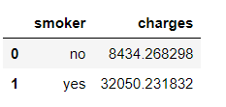
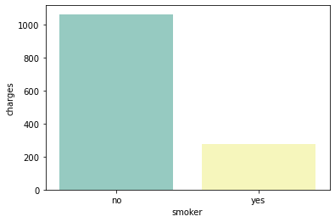
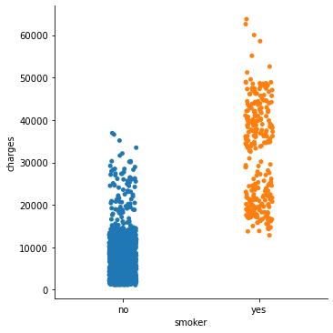
Statistical Analysis
Key question 2:
Prove (or disprove) that the medical claims made by the people who smoke is greater than those who don't?
Defining null and alternate hypotheses¶
Null hypothesis = "Mean charges of regular smokers is less than or equal to non-regular smokers"
Alternative hypothesis = "Mean charges of regular smokers is greater than non-regular smokers."

Slide 21
Key question 2 continue….
Decision on level of significance: 0.05
Identification of the test statistic: independent sample t test ( if Assumptions satisfied))
Assumptions of independent-sample t-test.
Assumption #1: The dependent variable should be measured on a continuous scale (i.e., it is measured at the interval or ratio level).
This condition is satisfied as charges variable is a continuous variable.
Assumption #2: our independent variable should consist of two categorical, independent groups.
This condition is satisfied as we have two groups.
Assumption #3: we should have independence of observations, which means that there is no relationship between the observations in each group or between the groups themselves. For example, there must be different participants in each 4. group with no participant being in more than one group.
it is also satisfied as regular and nonregular smokers are part of separate group
Assumption # 4: our dependent variable should be approximately normally distributed for each group of the independent variable (will be tested).
Assumption # 5: There needs to be homogeneity of variances. (will be tested)

Slide 22
Key question 2 continue….
testing assumption 4
shapiro Wilk test is applied to derive assumptions
our dependent variable should be approximately normally distributed for each group of the independent variable we created group of two dependent variables. one group estimates charges for insured those smoke frequently and the next group is for insured who do not frequently smoke.
Variable | Shapiro statistics | Sig value | Decision | Assumption
smoker_yes_charges | 0.9395521879196167 | 3.6251879276250065e-09 | Non normally distributed as p<0,05 | Not satisfied as per shapiro satististics.
Smoker_no_charges | .8728628158569336 | 1.4455900162299346e-28 | Non normally distributed as p<0,05

Slide 23
Key question 2 continue….
testing assumption 5
Levene test is applied
o be homogeneity of variances.
since independent sample assumptions are not fulfilled therefore we apply a non-parametric alternative Mannwhitney u test since it has more relaxed assumption.
levene statistics | Sig value | Decision | Assumption
403.26397655339804 | 1.3484459247996362e-78 | Variances are not equal as p<0,05 | Not satisfied
Decision on test

Slide 24
Results
Test Statistics | P value (for one tail test) | Decision | From the data, it can be concluded that "Mean charges of regular smokers is greater than non-regular smokers(U =7403.0 , p< 0.05).
U = 7403.0 | 1.3175583611258927e-130 | Reject null hypothesis

Slide 25
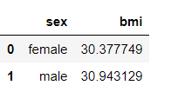
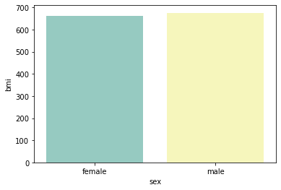
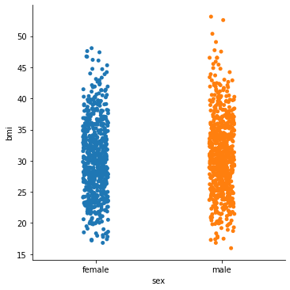
Statistical Analysis……
Key question 3:
Prove (or disprove) with statistical evidence that the BMI of females is different from that of males?
Defining null and alternate hypotheses
Null hypothesis = "there is no statistically significant difference in male and female bmi" or "male bmi is equal to female bmi“
Alternative hypothesis ="there is a staitically significant difference in male and female bmi" or "male bmi is not equal to female bmi"
this is a two tail test.

Slide 26
Key question 3 continue….
Decision on level of significance: 0.05
Identification of the test statistic: independent sample t test ( if Assumptions satisfied))
Assumptions of independent-sample t-test.
Assumption #1: The dependent variable should be measured on a continuous scale (i.e., it is measured at the interval or ratio level).
This condition is satisfied as charges variable is a bmi variable.
Assumption #2: our independent variable should consist of two categorical, independent groups.
This condition is satisfied as we have two groups.
Assumption #3: we should have independence of observations, which means that there is no relationship between the observations in each group or between the groups themselves. For example, there must be different participants in each 4. group with no participant being in more than one group.
it is also satisfied as male and female are part of separate group
Assumption # 4: our dependent variable should be approximately normally distributed for each group of the independent variable (will be tested).
Assumption # 5: There needs to be homogeneity of variances. (will be tested)

Slide 27
Key question 3 continue….
testing assumption 4
shapiro Wilk test is applied to derive assumptions
our dependent variable should be approximately normally distributed for each group of the independent variable we created group of two dependent variables. one group estimates male bmi and the next group is for female bmi.
Variable | Shapiro statistics | Sig value | Decision | Assumption
malebmi | 0.9930475354194641 | 0.003130641533061862 | Non normally distributed as p<0,05 | Not satisfied as per shapiro satististics.
femalebmi | 0.9930257797241211 | 0.0035433683078736067 | Non normally distributed as p<0,05

Slide 28
Key question 3 continue….
testing assumption 5
Levene test is applied
homogeneity of variances.
The only assumption of normality is not fullfiled but since the variances are equal and sample size is large therefore we will apply independent sample t test.
levene statistics | Sig value | Decision | Assumption
0.0030411494335658316 | 0.9560299025144636 | Variances are equal | satisfied
Decision on test

Slide 29
Results
Test Statistics | P value | Decision | From the data, it can be concluded that their no statistically significant difference in male and female bmi t(1.697), p>0.05, mean difference = .565379. thus this makes us retain our null hypothesis and reject the alternative hypothesis.
t = 1.696752635752224 | 0.089976 | Retain null hypothesis

Slide 30
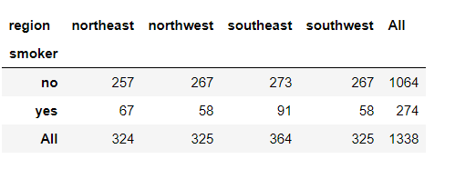
Statistical Analysis……
Key question 4 :
Is the proportion of smokers significantly different across different regions?
Defining null and alternate hypotheses
Null hypothesis: "The proportion of smokers is significantly equal across regions“
Alternative hypothesis: "proportion of smokers is significantly different across different regions"

Slide 31
Identification of the test statistic
Chi-square test of independence is applied
Assumptions for test:
Assumption #1: our two variables should be measured at an ordinal or nominal level (i.e., categorical data).
this condition is satisfied as both variables (smoker and region) are nominal
Assumption #2: our two variable should consist of two or more categorical, independent groups.
this condition is also satisfied as smoker (yes, no) & region (southeast, southwest, northeast and northwest) have independent categories.

Slide 32
Results
Test Statistics | P value | Decision | it can see here that χ2 = 7.43, p =>0.05. Thus we retain our null hypothesis that proportion of smokers is significantly equal across regions.
7.34347776140707 | 0.0617 | Retain null hypothesis

Slide 33
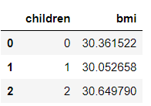
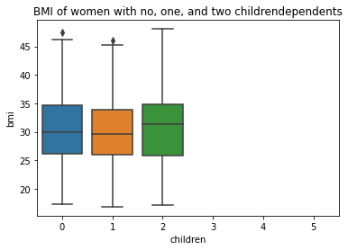
Statistical Analysis……
Key question 5 :
Is the mean BMI of women with no children, one child, and two children the same??
Defining null and alternate hypotheses
Null hypothesis: "mean BMI of women with no children, one child, and two children are same“
Alternative hypothesis: "mean BMI of women with no children, one child, and two children are different" or "at least one mean is different"

Slide 34
identification of test Statistics:¶
One way anova shall be applied as:
dependent variable of women bmi is measured at the interval or ratio level (i.e., it is continuous)
independent variable children (o,1 &2) consists of more than two, independent groups.
Results
Test Statistics | P value | Decision | since the sig value of one way anova is graeter than 0.05 therefore we retain the null hypothesis that mean BMI of women with no children, one child, and two children are same.
0.823263 | 0.533371 | Retain null hypothesis

Slide 35
Policy recommendations:
The insurance company should collect more data on various customer dynamics such as income, race etc so that more detail insights shall be generated.
The company should decide on more elaborated marketing techniques for the insurance customers with specific target to obesity as majority of the customers are above ideal BMI range.
The Company should introduce packages to attract customers having greater dependents since the company lacks customers with greater number of dependents. This should be one of the venue for companies earning.
Regional insurance sales should be focus and specific cultural and demographic factors should be considered for it.
The percentage of non-regular smokers is very less, it should be considered by company and reach with different touch points.
Youth or relatively young people should also be considered as a niche market. Small insurance palns should be introduced for them as insured at the age of 18 years are found in northeast and southeast but not in northwest and southwest
Southeast region should be analyzed as what has led to more sales in this region thus other regions can be focused according.

Slide 36
Further Analysis:
The highest spread is reported in the Age variable with respect to 0 number of children/dependents. The lowest average age variable spread is reported for insured having 5 children, this and various other findings also needs to elaborated.
The methodological choices for data collection needs to be changed and a mix method approach should be adopted. More detail Qualitative interviews shall be conducted for increasing customers and satisfying existing customers.
More sophisticated Explanatory data analysis techniques should be applied like Multinomial Logistic regression keeping different product as Dependent variable and the given other attributes as independent variables to come up with sound findings.
Cluster analysis and Multidimensional Scaling can be another explanatory technique to appear on sound findings.

Slide 37
Thankyou

